Slide 1
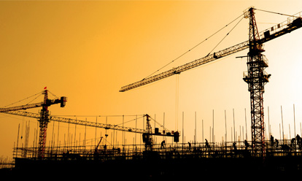
Environmental Impact & Long-Term Sustainability of Construction Projects (industry)
Dr. Parakrama Karunaratne
Department of Chemical and Process Engineering
University of Peradeniya

Slide 2
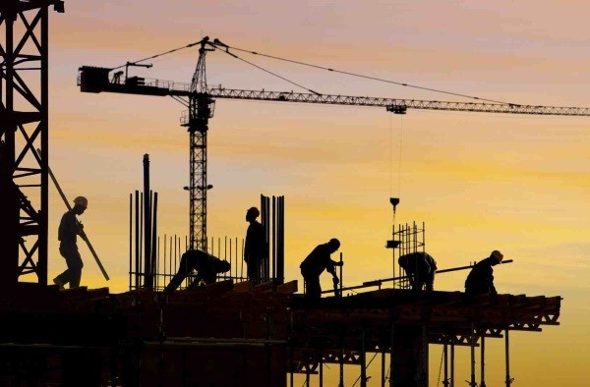
Construction Industry
Construction industry contribution to GDP ~6%
One of the highest growing industry in Sri Lanka
Increasing population, economic growth and urbanization mean increased construction related activities as well
The urban populations will nearly double within the next 40 years from about 2.6 to 5.3 billion people (Madlener and Sunak 2011).

Slide 3
Outline of the presentation
Local and Global Environmental Issues, with especial emphasis on global issues
Interaction between environment and built environment
Sustainability of Built environment

Slide 4
Environmental Impacts
Local
- Land clearance, loss of biodiversity
- Noise pollution
- Urban heat islands
- Local flooding
- Air, water pollution
Global
- Global warming
- Resource usage
- Ozone layer depletion

Slide 5
Environmental impacts - Local
80% of agricultural land loss is due to buildings
Urban flooding due to improper planning of cities
Disturbances in air circulations creating air quality hotspots/urban canyons
Creation of heat islands
Noise, dust and fumes generation during construction
System Disturbances
Most of them can be addressed though mechanisms such as IEE or EIAs
Notes:
Role of So called land developers in destroying lands

Slide 6
Environmental impacts - Global
Global warming
Resource depletion
Ozone layer depletion
Acidification

Slide 7
Environmental impacts - Global
Global warming

Slide 8
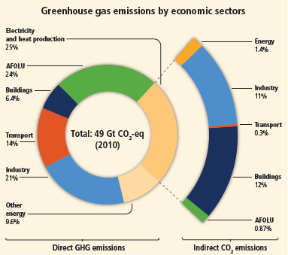
Emission in 2010 (IPCC 2014)
Direct emission from building sector- 6.5%
Total ~19%

Slide 9
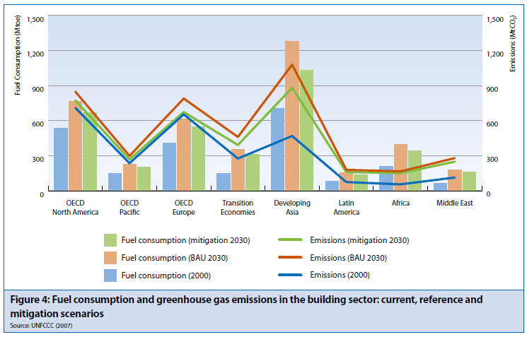
Contribution from Buildings

Slide 10
Contribution from Buildings
40% of world energy goes to building

Slide 11
Contribution from Buildings
50% of UK greenhouse gas emissions from running buildings...
10% of UK emissions coming from producing building materials... Source: UK Green Building Council
In the case of India 22% of CO₂ is related to the construction industry

Slide 12
Life Cycle Thinking
Amount of CO₂emissions which the construction industry has the ability to influence 2008 (Dept of Business Innovation and Skills 2010)

Slide 13
Interaction between climate change and built environment
GHG emission from Energy use and material production
Built Environment
Climate Change
Shift in Energy Use
Passive/natural system go out of range
HVAC capacity mismatch
Increased wind load
Urban Flooding

Slide 14
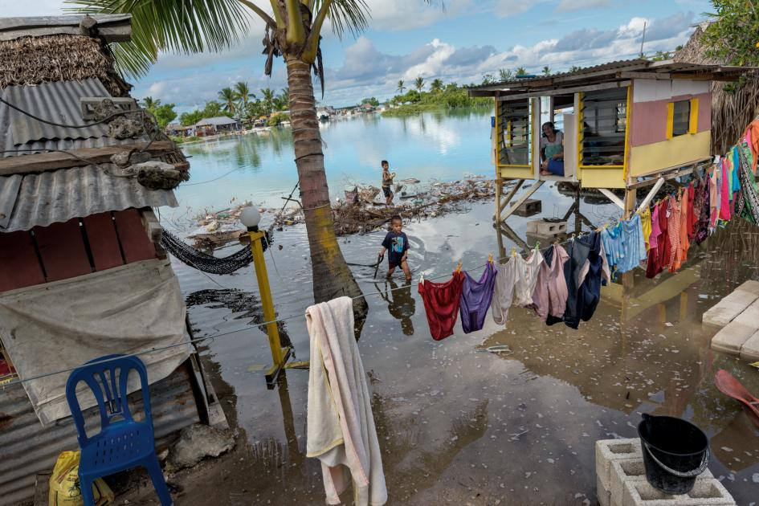
Sea Level Rise
“The IPCC says we can expect the oceans to rise between 11 and 38 inches (28 to 98 centimeters) by 2100, enough to swamp many of the cities along the U.S. East Coast. More dire estimates, including a complete meltdown of the Greenland ice sheet, place sea level rise to 23 ft (7 m), enough to submerge London.”
http://www.nationalgeographic.com/environment/global-warming/sea-level-rise/

Slide 15
Extreme Weather
Effects
Cyclones,
Heat waves,
Droughts,
Floods,

Slide 16
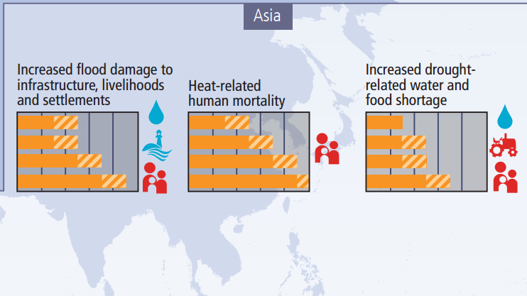
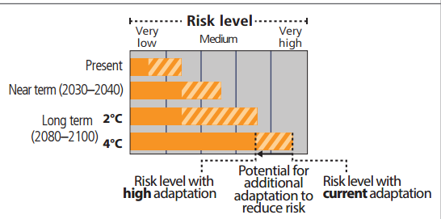
Climate change impacts

Slide 17
Impact 2- Material over-consumption

Slide 18
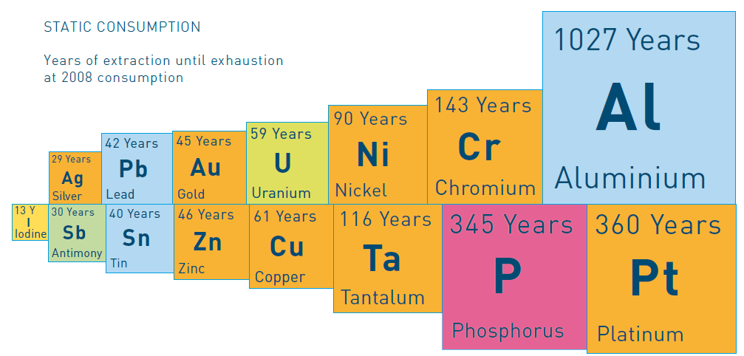
Projected availability of metals
13 Years
In
Indium
The Hague Centre for Strategic Studies- 2009
Predicted World’s Fe supply 150 years

Slide 19
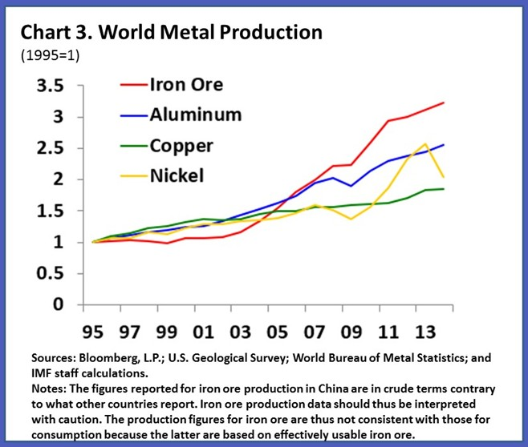

Slide 20
Resource Consumption by the building sector
Shares of metals used in construction industry
Metal | End-use Fraction | Predominant Metal-containing Final Goods
Aluminium | 25% | Siding, window frames
Antimony | 55% | Flame retardants
Chromium | 25% | Elevators, railways
Copper | 50% | Building wire and copper tube
Iron | 50% | Building beams, reinforcing bars
Lead | 58% | Lead sheet
Manganese | 29% | Structural steel
Nickel | 9% | Alloys
Zinc | 48% | Galvanised steel (e.g., frames, piping), zinc alloys (e.g., brass appliances), and pure zinc (e.g., roofing)
UNEP-2010
METAL STOCKS IN SOCIETY Scientific Synthesis

Slide 21
Estimate of global resources used in buildings
Resource | %
Energy | 45 - 50
Water | 50
Materials for buildings and roads (by bulk) | 60
Agricultural land loss to buildings | 80
Timber products for construction | 60 (90% of hardwoods)
Coral reef destruction | 50 (indirect)
Rainforest destruction | 25 (indirect)
Hawken, P et al 1996

Slide 22
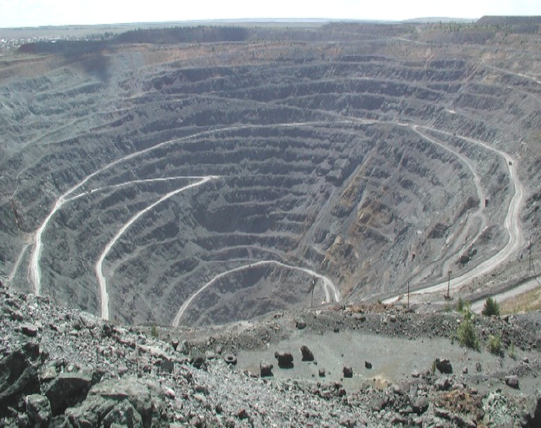
Physical disturbance to the landscape due to mining
Sibai copper mine ( Russia )
Ref: Francis Cottard

Slide 23
Waste Rock disposal
Ref: Francis Cottard

Slide 24
Acid Mine Drainage
Ref: Francis Cottard

Slide 25
Erosion of waste rocks dumps
Ref: Francis Cottard

Slide 26
Toxic emissions
Ref: Francis Cottard

Slide 27
Contribution to pollution
Pollution | (%)
Air quality (cities) | 23
Climate change gases | 50
Drinking water pollution | 40
Landfill waste | 50
Ozone depletion | 50

Slide 28
Built Env. Sustainability
Economic
- Most of the time, taken care of
- Contribution to the economic development
- Adoptability to technological advances
- Energy and Material Efficiency
Social
- Should cater human aspiration & expectations
- Affordability to masses
- Health and Safety
- Indoor environment
Environmental
- Climate adoptability
- Material and Energy efficiency
- System and intergraded approach at design
IEA-2007

Slide 29
Macroscopic
Level
Mesoscopic
Level
Microscopic
Level
Smart and sustainable development of built environment
Innovative Technologies
Econ. Targets
Urban Planning
GHG Reduction
Health and Safety Principles
Community Issues
Social Targets
Energy Efficient Design
Transport
Energy Efficient Design
Human Values & Aspirations
Env. Targets
Renewable energy
Water Management
Land Administration
Building Design
Political Targets
Material Selection
Public health
Indoor Environment
Emerging Targets
Life Cycle Operation
BMS
Recycling
Green Procurement
Deconstruction and reuse

Slide 30
Planning Process
Sea level rise
Extreme weather events
Flooding
Increased wind speeds
Temperature rise
Effect of air Pollution
Planning
Transport
Social Interactions
Microclimate
Acoustics
Drainage
Waste
Climate
Urban
LCA & Materials
Renewable energy
Efficient building design
Robustness (functional and technological)
Indoor environment
Simulation
Deconstruction & Reuse
Sustainable Built Environment
Buildings
Occupant behavior
Building assessment
Building Info Management
Energy Management
Sustainable Procurement
Waste Management
Management

Slide 31
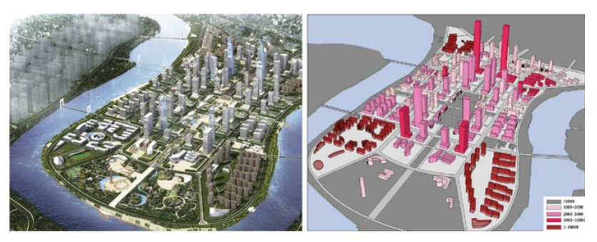
Need for Overall planning
Concept design for the Yujiabu central business district (CBD) in Binhai, Tianjin

Slide 32
The choice of these materials must focus on...
• Non toxic materials;
• Materials with low embodied energy;
• Recyclable materials;
• Materials containing wastes from other industries;
• Materials obtained from renewable resources;
• Materials with high durability;
• Materials with self-cleaning ability and capable of reducing air pollution.
Local materials

Slide 33
Embodied energy in different building parts.
ASSEMBLY | EMBODIED ENERGY kWh/m²
WALLS
Timber frame, timber weatherboard, plasterboard lining | 52
Timber frame, clay brick veneer, plasterboard lining | 156
Timber frame, aluminium weatherboard, plasterboard lining | 112
Steel frame, clay brick veneer, plasterboard lining | 168
Double clay brick, plasterboard lined | 252
Cement stabilised rammed earth | 104
FLOORS
Elevated timber floor | 81
110 mm concrete slab on ground | 179
200 mm precast concrete T beam/infill | 112
ROOFS
Timber frame, concrete tile, plasterboard ceiling | 70
Timber frame, terracotta tile, plasterboard ceiling | 75
Timber frame, steel sheet, plasterboard ceiling | 92
Source : Lawson 1996.

Slide 34
Summary
Construction industry is one of the largest and important contributor to economic development
Can have significant local and global environmental impacts
Macro, Meso and microscopic planning is the key to sustainability
Guidelines such as green building incorporates these considerations

Slide 35
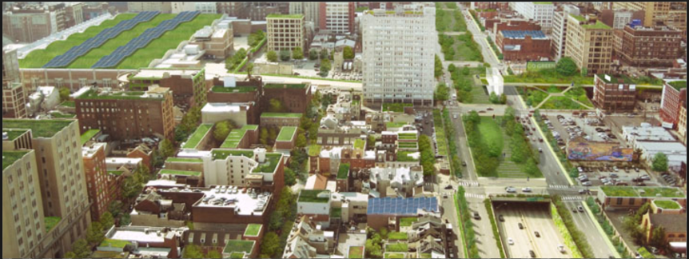
Thank you!

Slide 36
References
Runming Yao, 2013, Design and Management of Sustainable Built Environments, Springer
Patrick Chalmers, 2004, Climate Change: Implications for Buildings, University of Cambridge

